Slide 1
Programming Workshop
The universal background to computer programming

Slide 2
Programming as a language
Math
X = 2 + 5
Y = X – 7
English
While figuring out X, see if Y equals zero
If Y equals zero, stop calculating X

Slide 3
Types of programming: Simple to Complex
One line code
X = 12
Procedural code
If x equals 12,
then make y equal 14
If y equals 14…
Method code
Circle with x as diameter
Functional code
Figure out x,y,z, and some other things along the way
Function xyzetc(x, y, z, etc)
Abstract code(i.e. object-oriented)
The really complicated stuff, beyond our scope today

Slide 4
Basics
Data Types
Constants
1, 456, 3
Integers
X = 12
Floats
X = 1.2
Characters
X = “F”
Strings
X = “Fun”
Boolean
X = True or X = False
Arrays(lists, dictionaries, etc.)
X = [12, 1.2, “F”, “Fun]

Slide 5
Basics
Operators - basic math and the dreaded = vs. ==
+, -, /, %, *
= this is the assignment operator, meaning assign to left side variable the value on the right side (i.e. X = 12, now X holds the value 12)
== this is the equivalency operator, meaning test if the values on left and right sides are equal to each other (i.e. X = 12, so X == 12 is True, X == 13 is False)
! Not operator, means opposite (different in different languages)

Slide 6
Basics
Variables
Setting values to a name, just like algebra
X = 12
Fun = “programming is fun”
Number_or_string = “24”
Variables cannot be named after constants
12 = 12 will crash everything

Slide 7
Basics
Logic and loops
If
If x == 12
Else
If x == 12: y = 2, Else: y = 4
For
For(x = 0, x < 12, x = x + 1): y = x + 12, print y
While
While x < 12: x = x + 1, y = x + 12, print y

Slide 8
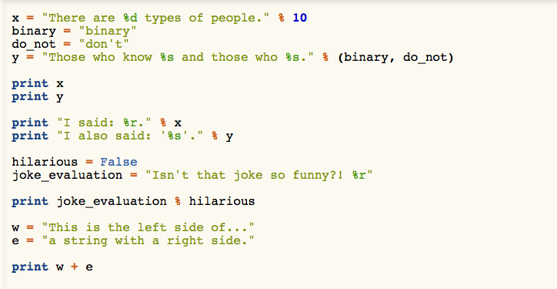
Why are things are this way, an example in code

Slide 9
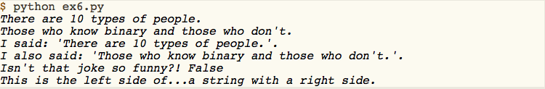
Why are things are this way, an example in code

Slide 10
Methods, or small repetitive tasks (a.k.a. inevitably reinventing the wheel)
Type conversions
X = 12
Y = float(x)
adding to arrays
X = [1, 2, 3]
X.append(4)
max & min values
Max(x) ----- 4
Min(x) ----- 1

Slide 11
Functions, or stop doing the same thing repeatedly
Solving problems efficiently without copy and paste
Tough questions: When is it time for a function?

Slide 12
Thinking about the future: reusing code and abstract code
Object-oriented programming
Thinking about future projects/needs

